Slide 1
20% Off the Job Hours
Silvia Pinto
Apprenticeship Programme Officer
Tuesday 30/03/2021

Slide 2
Agenda
What the difference is between off the job / on the job
What counts towards your off the job training
How to log into Smart Assessor
How to add OTJH to Smart Assessor
Matching activity types to descriptions on Smart Assessor
Off the job Calculations
Commitment Statements
Apprenticeship Agreements

Slide 3
What is off the job training?
Off the job training is training received by the apprentice, during the apprentices paid hours, for the purpose of achieving their apprenticeship
Off the job is a statutory requirement for an English apprenticeship
Off the job must be directly relevant to the apprenticeship framework or standard, teaching new KNOWLEDGE, SKILLS and BEHAVIOURS required to reach competence in the particular area

Slide 4
What is on the job training?
By this we mean training that does NOT specifically link to the KNOWLEDGE, SKILLS and BEHAVIOUR of the apprenticeship.
on-the-job training is training received by the apprentice for the sole purpose of enabling the apprentice to perform the work for which they have been employed

Slide 5
What counts towards Off the Job Training?
Masterclasses
Individual study time could include the following:
Completing project work for their apprenticeship
Online learning
Completing workplace reflection diaries.
(These are a great way to embed learning)
Shadowing L&D manager
Research tasks e.g. to gain new knowledge of your industry
Preparation for assessments
Meeting with learning coach

Slide 6
How are we going to document Off the Job Training?
Smart Assessor
http://www.smartassessor.co.uk/Account
https://www.smartassessor.co.uk/LearnerDashboard/LearnerDashboard
Email from Smart assessor requesting you follow the link to change your password and activate your account
Step by step on how to log activities in your time log

Slide 7
Matching Activity types on Smart Assessor
Description on Smart Assessor | Activity type
Traditional face-to-face session / Virtual Training Session | Masterclasses
Electronic or distant learning, or self-study | Individual study time could include the following: •Completing project work for their apprenticeship •Online learning •Completing workplace reflection diaries. (These are a great way to embed learning)
Coaching or mentoring | Shadowing L&D manager / mentors
Guided learning with no trainer / assessor present | Research tasks e.g. to gain new knowledge of your industry against checklist below
Gaining technical experience by doing my job | On the job training (work not attached to Knowledge, skills and behaviour)
Electronic or distant learning, or self-study | Preparation for assessments
Review / feedback / support | Meeting with learning coach

Slide 8
Examples
Time spent with our IT department regarding how to better utilise our employee database system to get much better functionality out of it - began planning how to do this so that it will improve the entire business efficiency (Shadowing)
Time spent getting coached by my line manager so that I can ask any questions I have in order to carry out the proper performance of my job role. (Coaching & Mentoring)
Got taught about how my responses on an insights questionnaire correlate to a personality colour and how that corresponds to how i behave and get on with people from different colours according to the colour wheel. Also briefly learnt about the 4 levels of listening (Traditional face-to-face session)

Slide 9
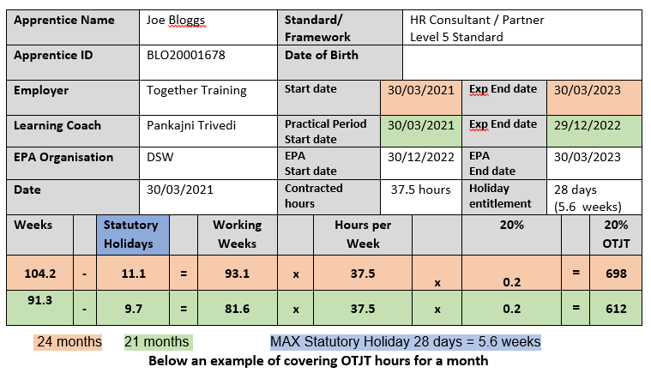
Off the job Calculation
All apprentices will have received an off the job calculation in your welcome email

Slide 10
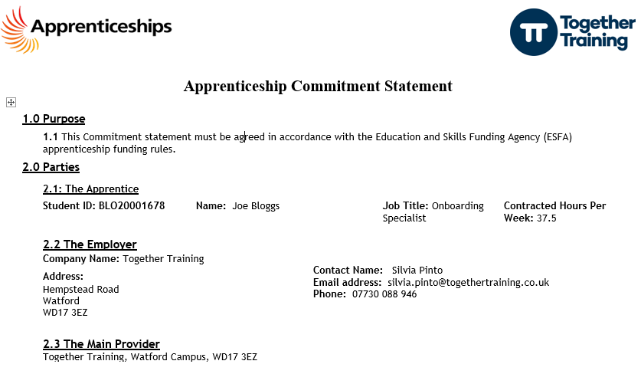
Commitment Statement
Below will be sent through DocuSign to your line manager / mentor to sign. Once signed the signed copy will be sent to the apprentice to sign.

Slide 11
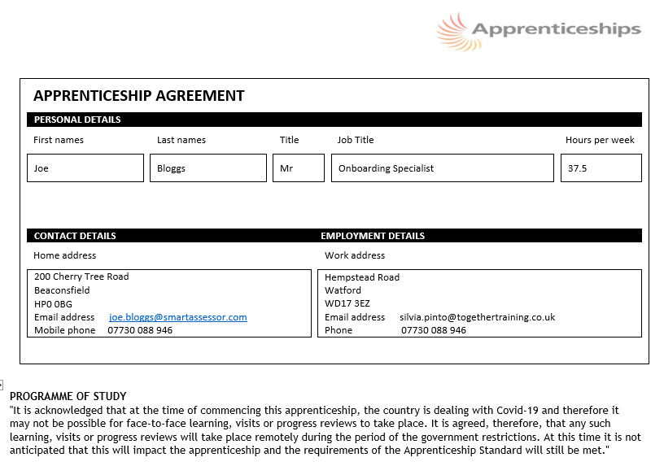
Apprenticeship Agreement
Below will be sent through DocuSign to your learning & development manager to sign. Once signed the signed copy will be sent to the apprentice to sign.

Slide 12
Questions & Answers
Any concerns speak directly to your Learning Coach
Pankajni.trivedi@togethertraining.co.uk
Felicity Profit – Delivery Manager
Felicity.profit@togethertraining.co.uk
John McMahon – Director
John.mcmahon@togethertraining.co.uk

